Slide 1
QCL with function generator and SR830 lock-in amplifier
August 2024

Slide 2
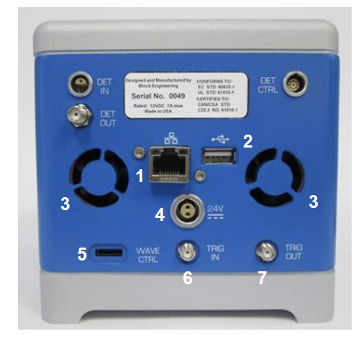
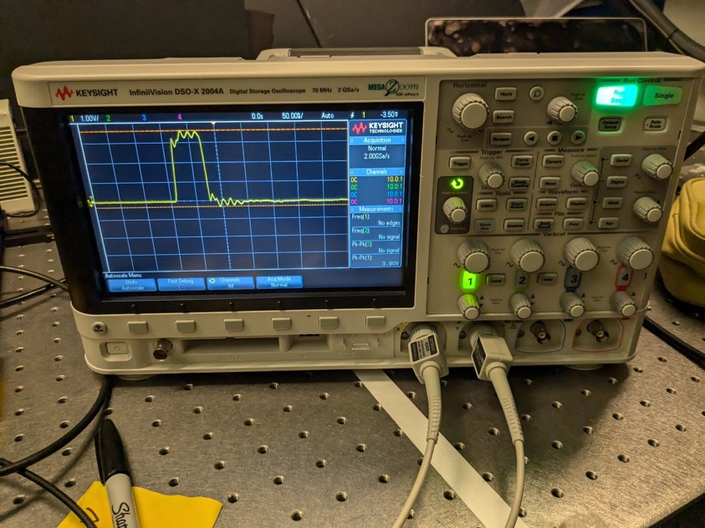
The SR830 was not able to pick up the Trig-Out signal from the LaserTune
According to the Stanford Research system tech, the 50 ns pulse duration is too short for the system to pick up
I measured the Trig-out from the QCL using an oscilloscope (laser must be on)

Slide 3
External trigger requirements for LaserTune QCL
The same pulse duration and duty cycle limits apply whether the system is internally or externally triggered.
For the LaserTune:
Maximum allowed duty cycle is 8% at short pulse lengths and lower at longer pulse lengths.
The LaserTune is set up to accept a 3V trigger signal alternating between 0 and 3V. Please be careful not to deliver more than 5V to the LaserTune.
In regards to the 50 ns pulse duration being too short for the lock-in, this problem is addressed by one of the operating modes of the LaserTune:
When operating the LaserTune by external trigger there are two modes: externally triggered and externally controlled. In externally triggered the LaserTune will match the repetition rate of the delivered trigger signal with the pulse width that is set in the user interface. In external control mode the LaserTune will match the repetition rate of the trigger signal as well as the pulse duration.
In your case, I would recommend using externally triggered. With this mode you can set the pulse duration of the trigger signal to something longer like 150 ns while maintaining your pulse duration at 50 ns via the user interface.

Slide 4
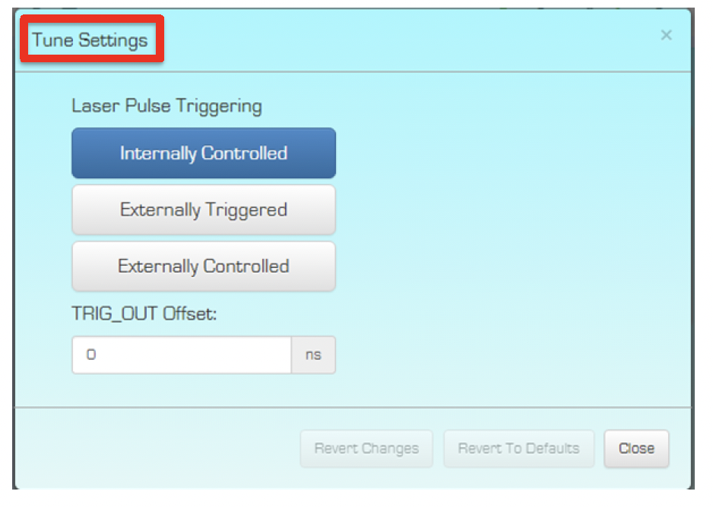
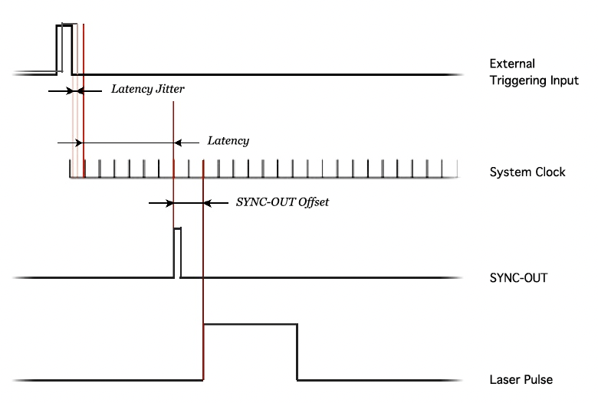
Externally Triggered setting
Externally Triggered
With this option TRIG IN (Trigger In) SMA input pulses control when the laser is fired. For example, an external pulse generator with pulses 0 to 2.5 Volts, period 1 microsecond, and width 50 nanoseconds – 5% Duty Cycle – would cause LaserTune to fire the laser when Start Laser is clicked on.
However the external pulse 50 nanoseconds width is ignored, the internal Pulse Duration is used. Keep the Duty Cycle of the input pulse train < 15% in all cases.

Slide 5
Externally Triggered requirements
Voltage limits:
The LaserTune is set up to accept a 3V trigger signal alternating between 0 and 3V.
Do not deliver more than 5V to the LaserTune.
Duty Cycle:
Maximum allowed duty cycle is 8% at short pulse lengths and lower at longer pulse lengths. (according to Block tech support) keep the pulse duration to 300 ns or lower
When the Externally Triggered is enabled, the LaserTune monitors the rising edge of a DC input that is above a threshold limit of 2.5 V on the TRIG IN port every 16ns (System Clock 125 MHz). When the system detects a trigger signal between clock cycles, it will fire the IR laser at the next clock cycle plus the fixed delay (i.e., the Latency) with a latency jitter specification of ~+/- 8 ns. The TRIG OUT signal is a TTL pulse to synchronize the laser pulse with other instruments and its time offset from the laser pulse is programmable via the Tune Mode – Settings section of the software. A schematic overview of the External Sync Triggering process is shown in the figure be-low.

Slide 6
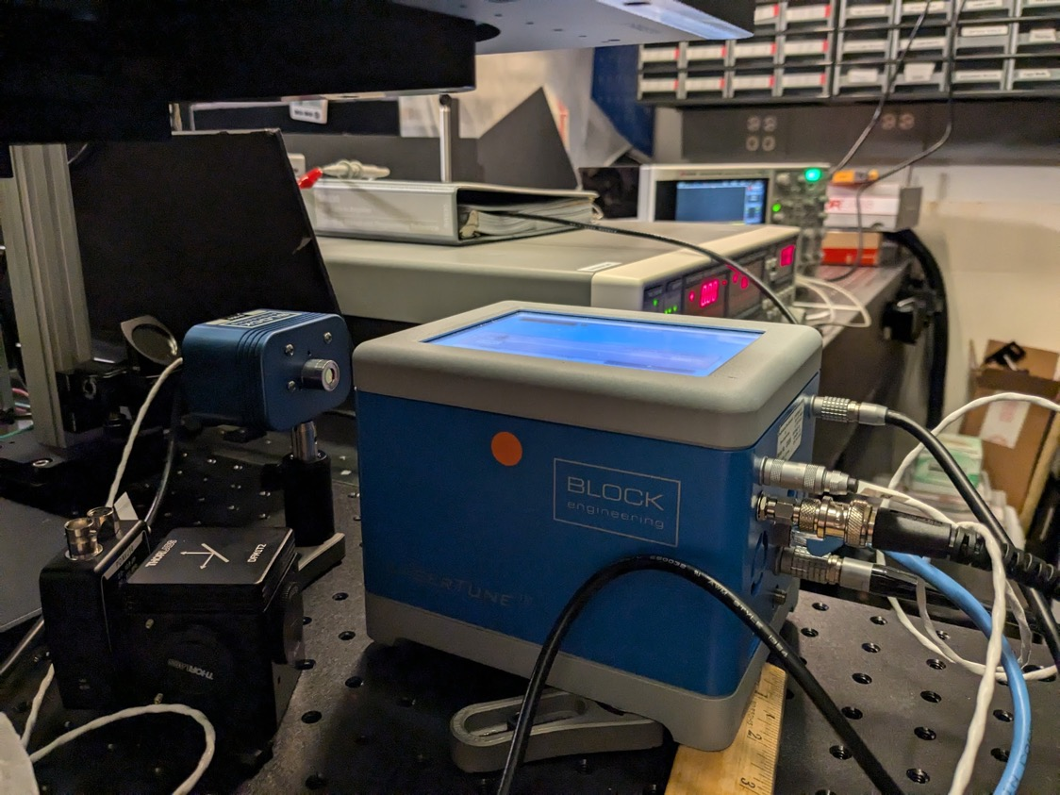

Slide 7
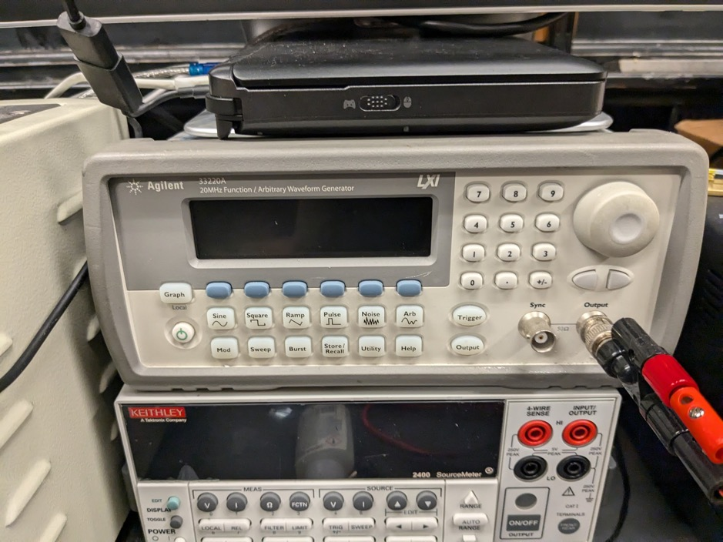
I tested external triggering with the Agilent 33220A that Mathias had in his lab
I used a pulse width of 200 ns, frequency of – Hz for a duty cycle of 2% and it worked! I set the Vpp to 2.5V (low = 0, high = 2.5V)

Slide 8
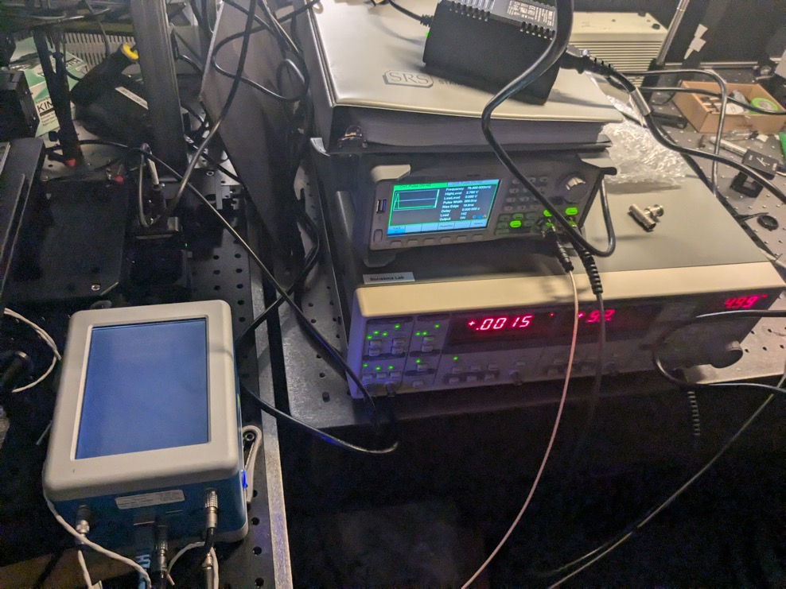
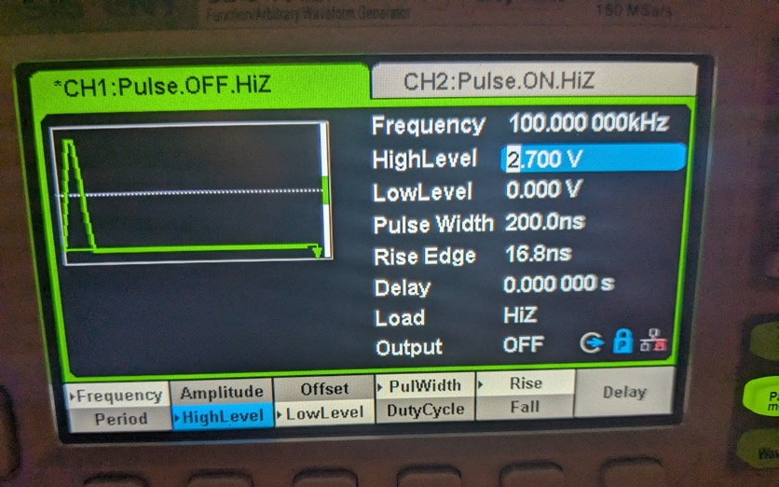
System now works by triggering the QCL and lock-in with the two output ports from a signet function generator
The lock-in does not like very short pulse widths with low V_{pp}, so I must tune the function generator to a goldilocks region for both the QCL and lock in
Current parameters that work for both

Slide 9
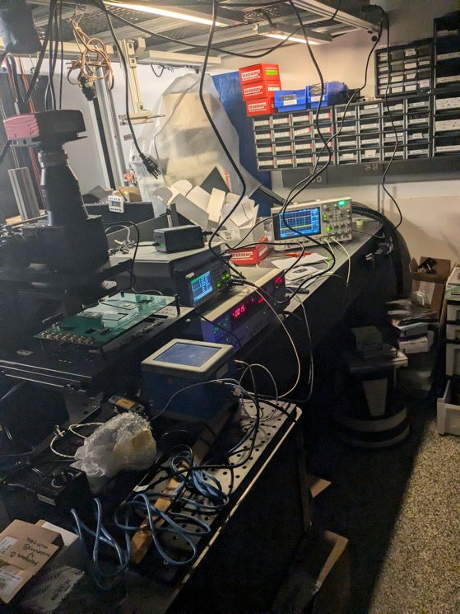
Laser trigger System works with Thorlabs detector
Lock-in triggered by func gen
QCL triggered by func gen
Output of Thorlabs MIR detector successfully read by lock-in
Next steps: get alignment working and MIR detector in system and meas reflection map + current map w/ lock in!

